Slide 1
Employee Data Analysis using Excel
STUDENT NAME:
REGISTER NO: 312213322 CAB18FD353CF977915A45021100736B9
DEPARTMENT: B.COM.B M .BANK MANAGEMENT
COLLEGE : TAGORE COLLEGE OF ARTS AND SCIENCE
R.PREETHI

Slide 2
PROJECT TITLE
Employee Performance Analysis using Excel

Slide 3


AGENDA
Problem Statement
Project Overview
End Users
Our Solution and Proposition
Dataset Description
Modelling Approach
Results and Discussion
Conclusion
3/21/2024 Annual Review

Slide 4

PROBLEM STATEMENT
To write a problem statement on employee performance, you need to identify the specific area of performance that is problematic, such as low productivity, high absenteeism, or poor quality of work. Then, you should describe the impact of this problem on the organization, such as decreased revenue or dissatisfied customers.

Slide 5

PROJECT OVERVIEW
Employee performance analysis
.
involves evaluating various metrics such as productivity, efficiency, and output quality to assess individual and team performance. By leveraging data analytics, organizations can identify top performers, areas for improvement, and potential training needs.

Slide 6

WHO ARE THE END USERS?
This Employee performance analysis Project to useful in manage employers and employer to organization and it sector to all in this employee management to benefits
THE END USERS
manage
employers
employer
Organization and management

Slide 7
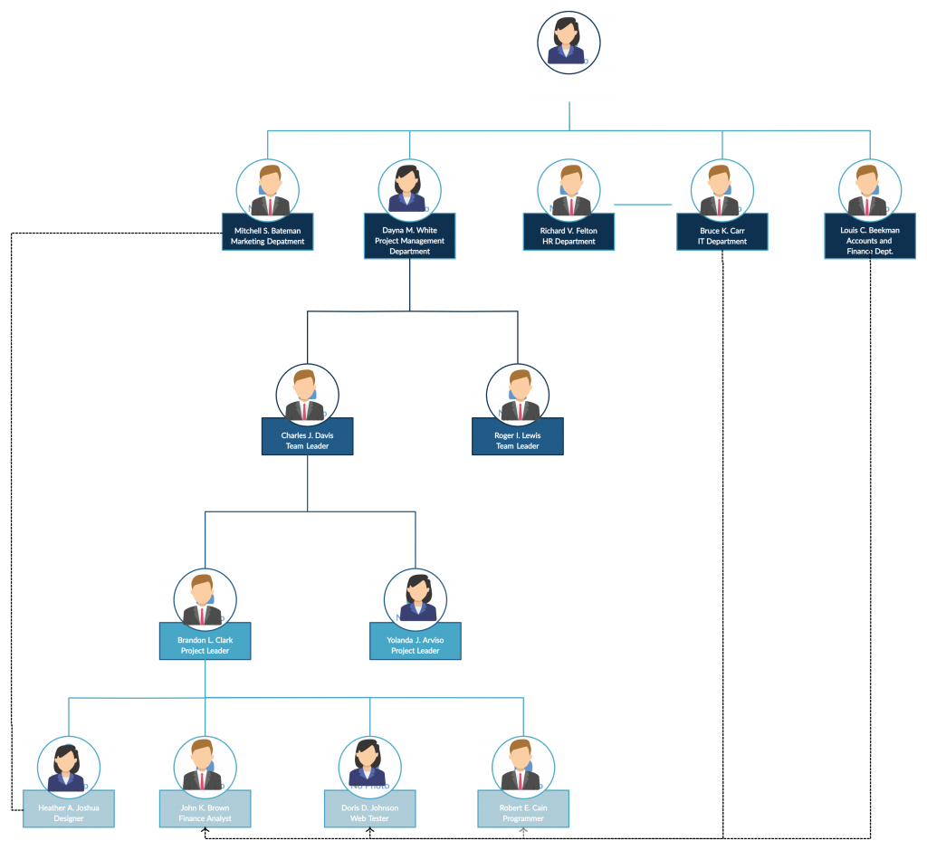

WHO ARE THE END USERS?

Slide 8

OUR SOLUTION AND ITS VALUE PROPOSITION
Conditional formatting-missing
Filter-remove
Formula-performance
Pivot-summary
Graph-data visualiztion

Slide 9
Dataset Description
Employee=-Kaggle
26-features
9-features
Emp id-num
Name-text
Emp type
Performance level
Gender-male female
Employee rating-num

Slide 10

THE "WOW" IN OUR SOLUTION
Performance level=IFS(Z8>=5,”VERY
HIGH”,Z8>=4,”HIGH”,Z8>=3,”MED”,TRUE,”LOW”)
3/21/2024 Annual Review
10

Slide 11
MODELLING
Data collection
1)This data set to download in koggle
2)Employee data set analysis to excel
3)To analysis to data set create to data chart design
Feature collection
1)Data set to feature to employer Performance level calculus
2)Employers highest level performance identity
Data cleaning
1)Missing values identity
2)Missing values filter out
Performance level
1)Excel software to use and employer data set to analysis
2)And create to data chart
Summary
1)Po table to powerpoint to use analysis
11

Slide 12
RESULTS
12

Slide 13
RESULTS

Slide 14
conclusion
conclusion to this employee Performance medium level employee to high and this medium employee to motivate move on next level

